Slide 1
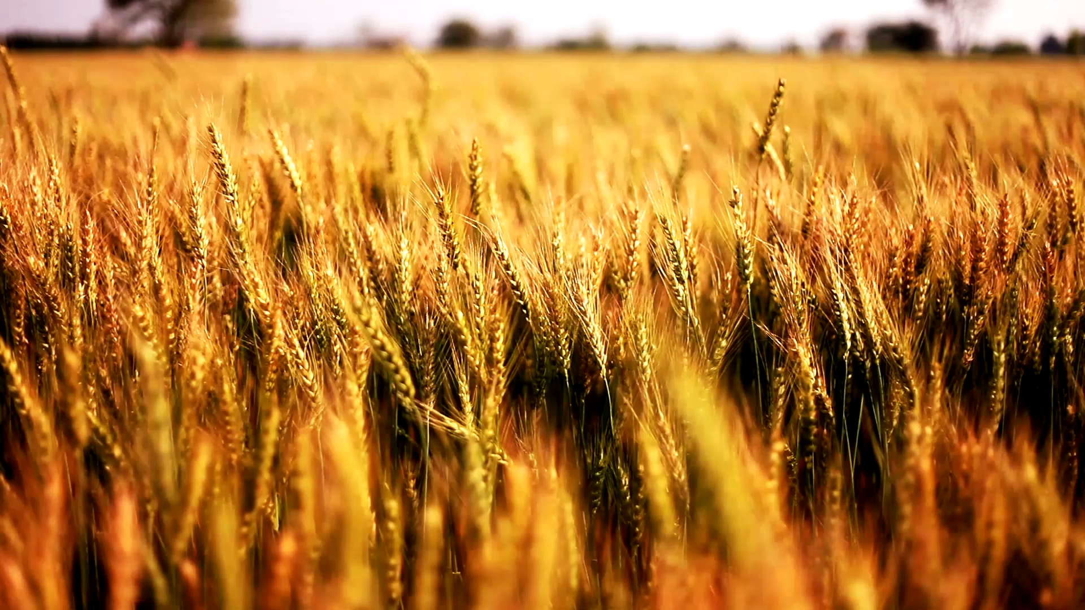
Analyzing the Impact of Environmental Factors on Crop Production in India
A Data-Driven Approach for Optimizing Agriculture

Slide 2

Introduction
Context: Agriculture in India is heavily reliant on environmental factors such as temperature, wind speed, and precipitation. Optimizing crop yield requires a thorough understanding of how these factors influence production in different regions.
Objective: This analysis explores the relationship between crop production and environmental variables (temperature, wind speed, and precipitation) in the top-producing states of India.

Slide 3
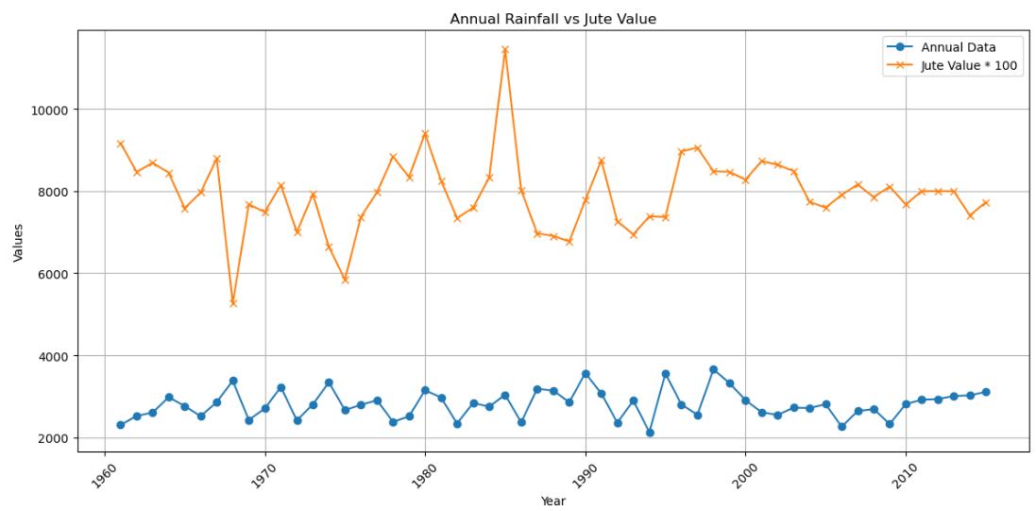
Hypotheses
The Influence of Temperature on High-Value Crops: Higher temperatures are expected to have a negative impact on the production of crops like wheat and rice, particularly in regions like Uttar Pradesh and Tamil Nadu.
Precipitation's Role in High-Yield States: Regions like Kerala and West Bengal will see an increase in crop production (especially rice and maize) with moderate to high levels of precipitation, whereas over-reliance on precipitation in states like Bihar limits production diversity.

Slide 4
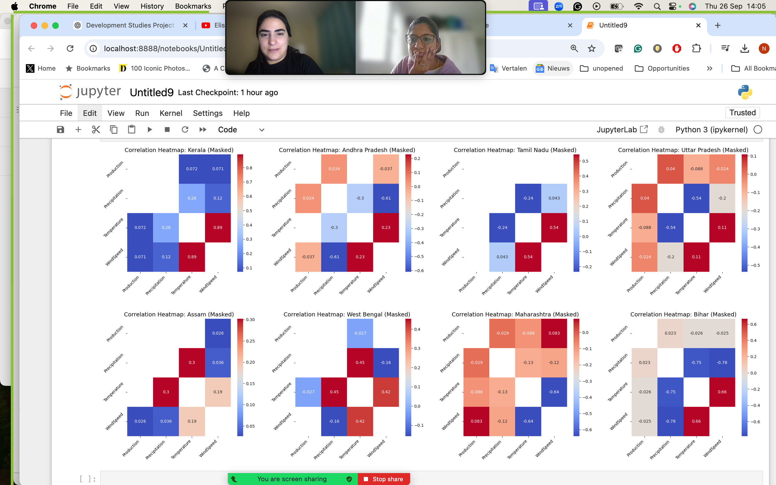
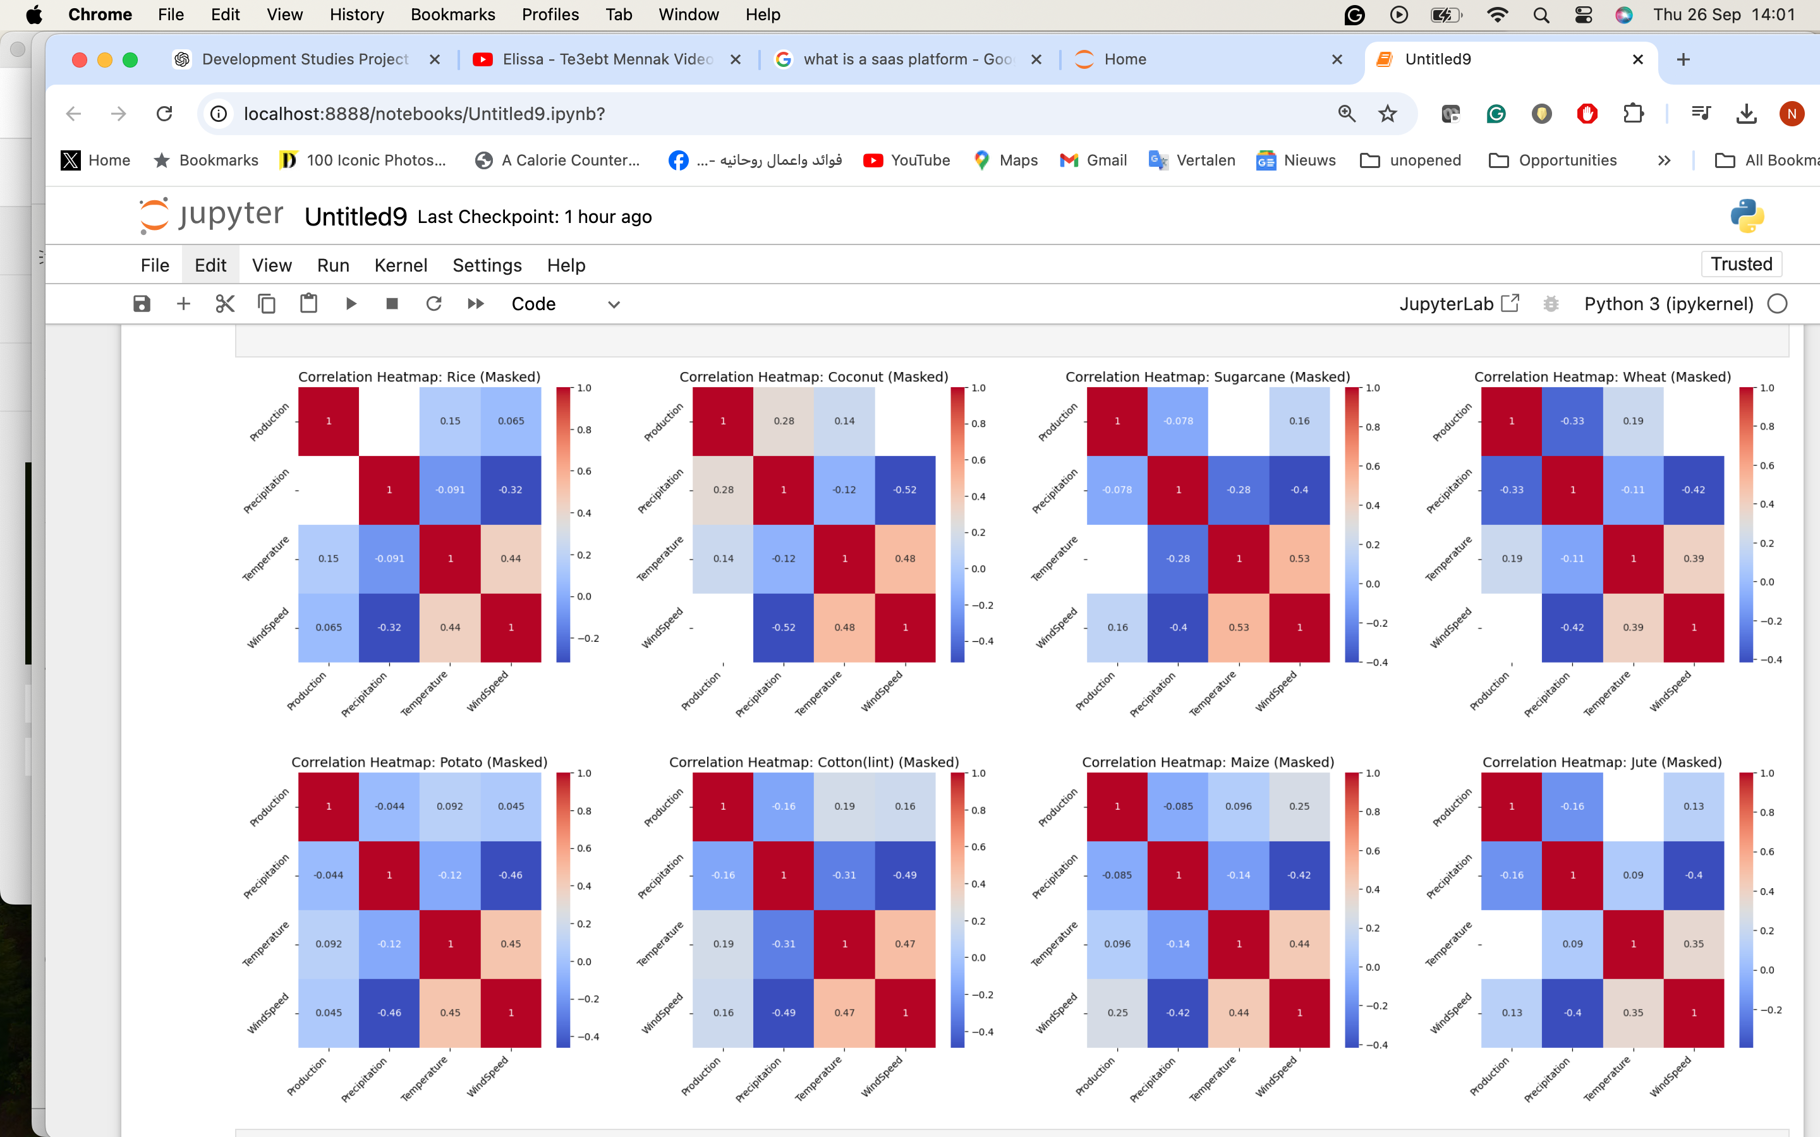
Key Insights
Regional Differences: Each state exhibits different responses to environmental variables. For example, Andhra Pradesh and Kerala show more sensitivity to precipitation, whereas Bihar and Tamil Nadu are more influenced by temperature fluctuations.
Crop-Specific Variations: Certain crops, such as rice and wheat, are more resilient to wind speed, while crops like jute are sensitive to even slight changes in wind speed and precipitation.

Slide 5
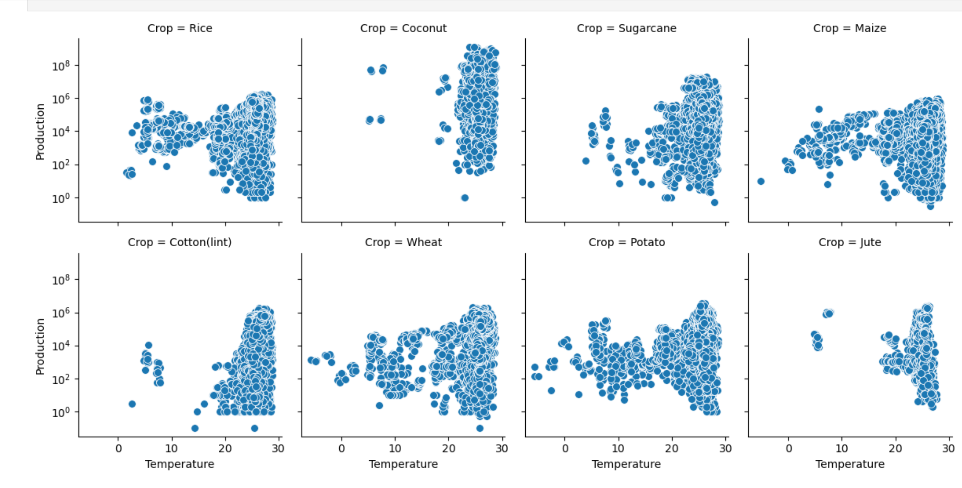
Temperature Correlation Across Crops
Crops like Rice, Cotton, Wheat, and Potato strongly correlate with specific temperature ranges. Crops like Coconut and Sugarcane have a narrower optimal temperature range for higher production.

Slide 6
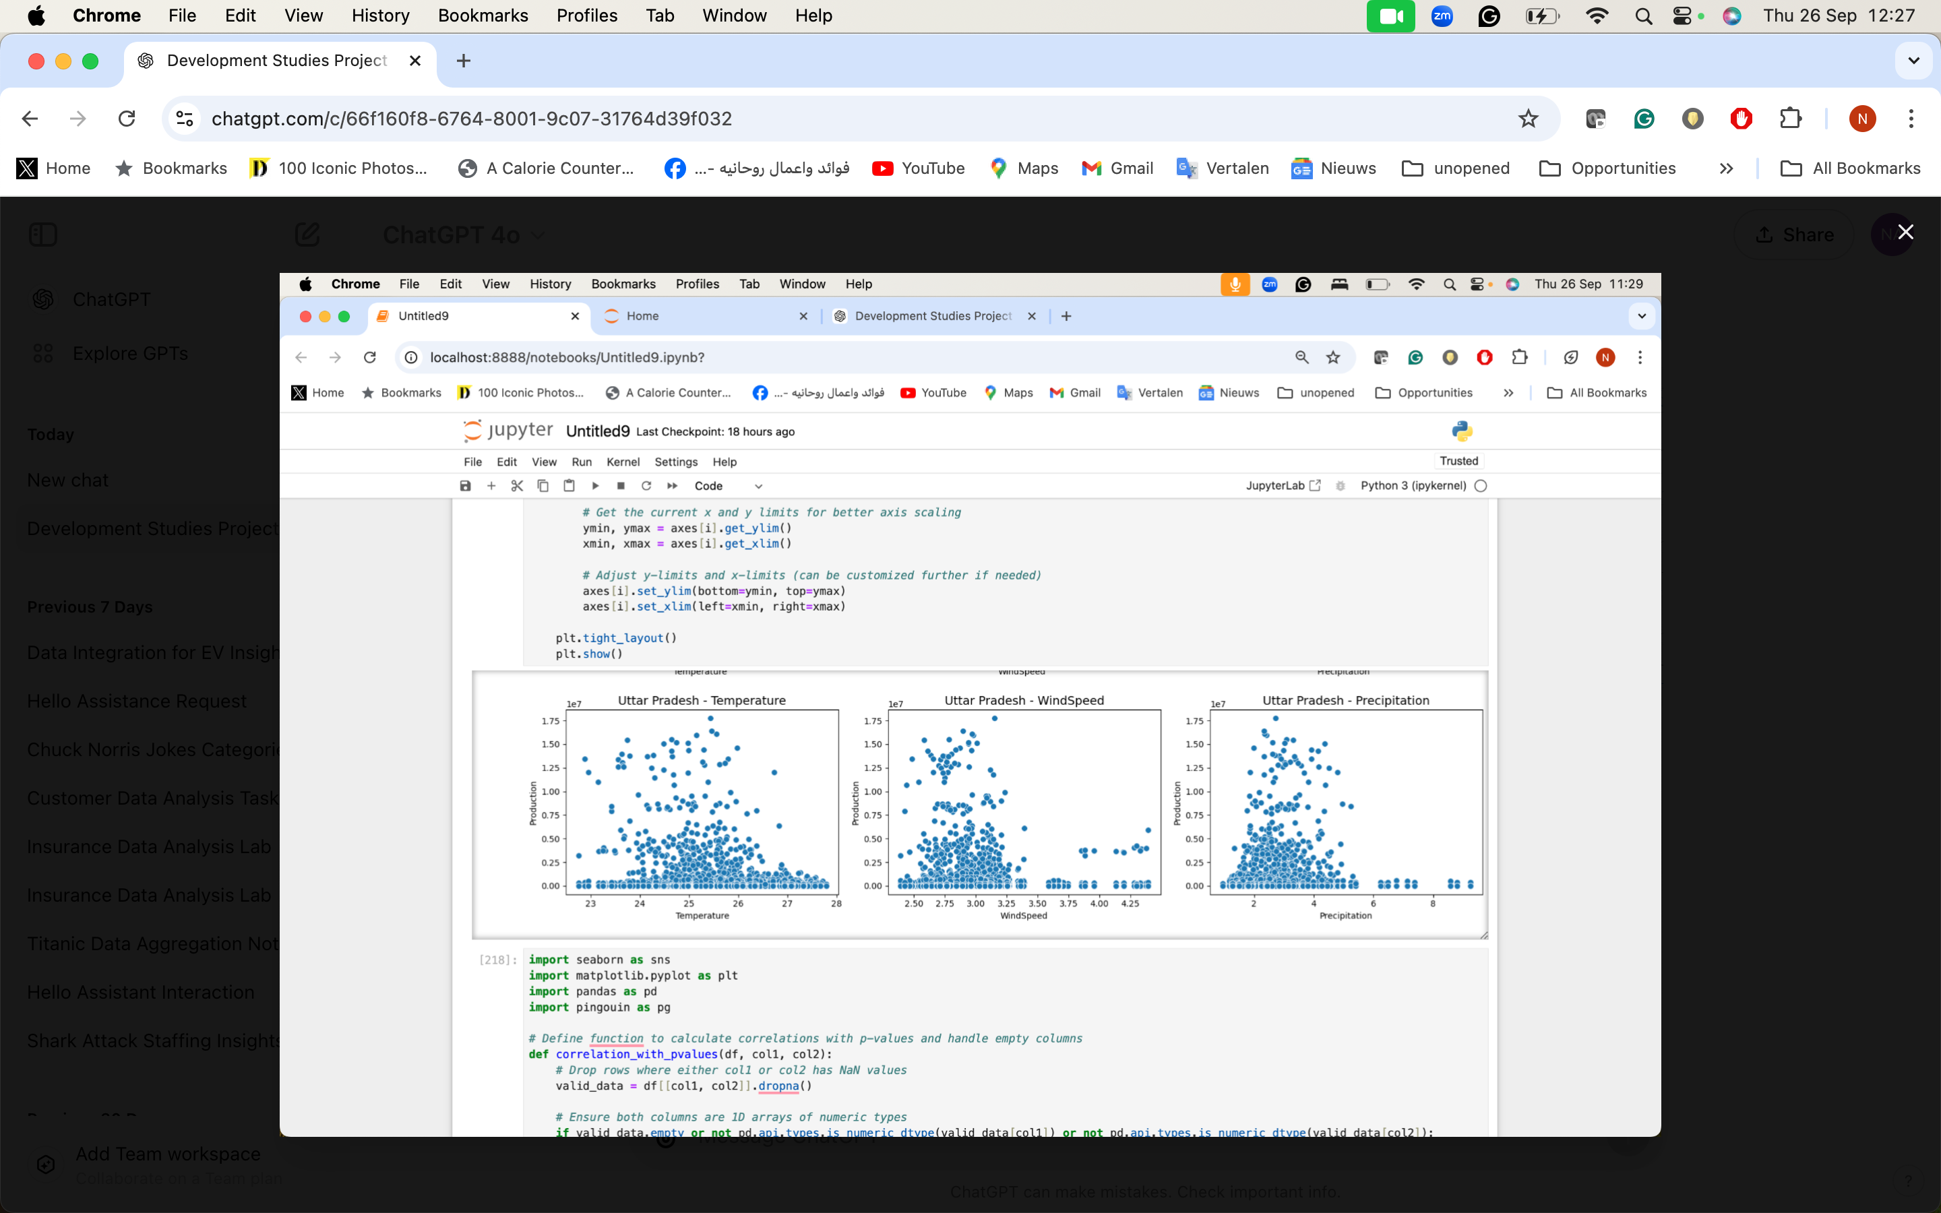
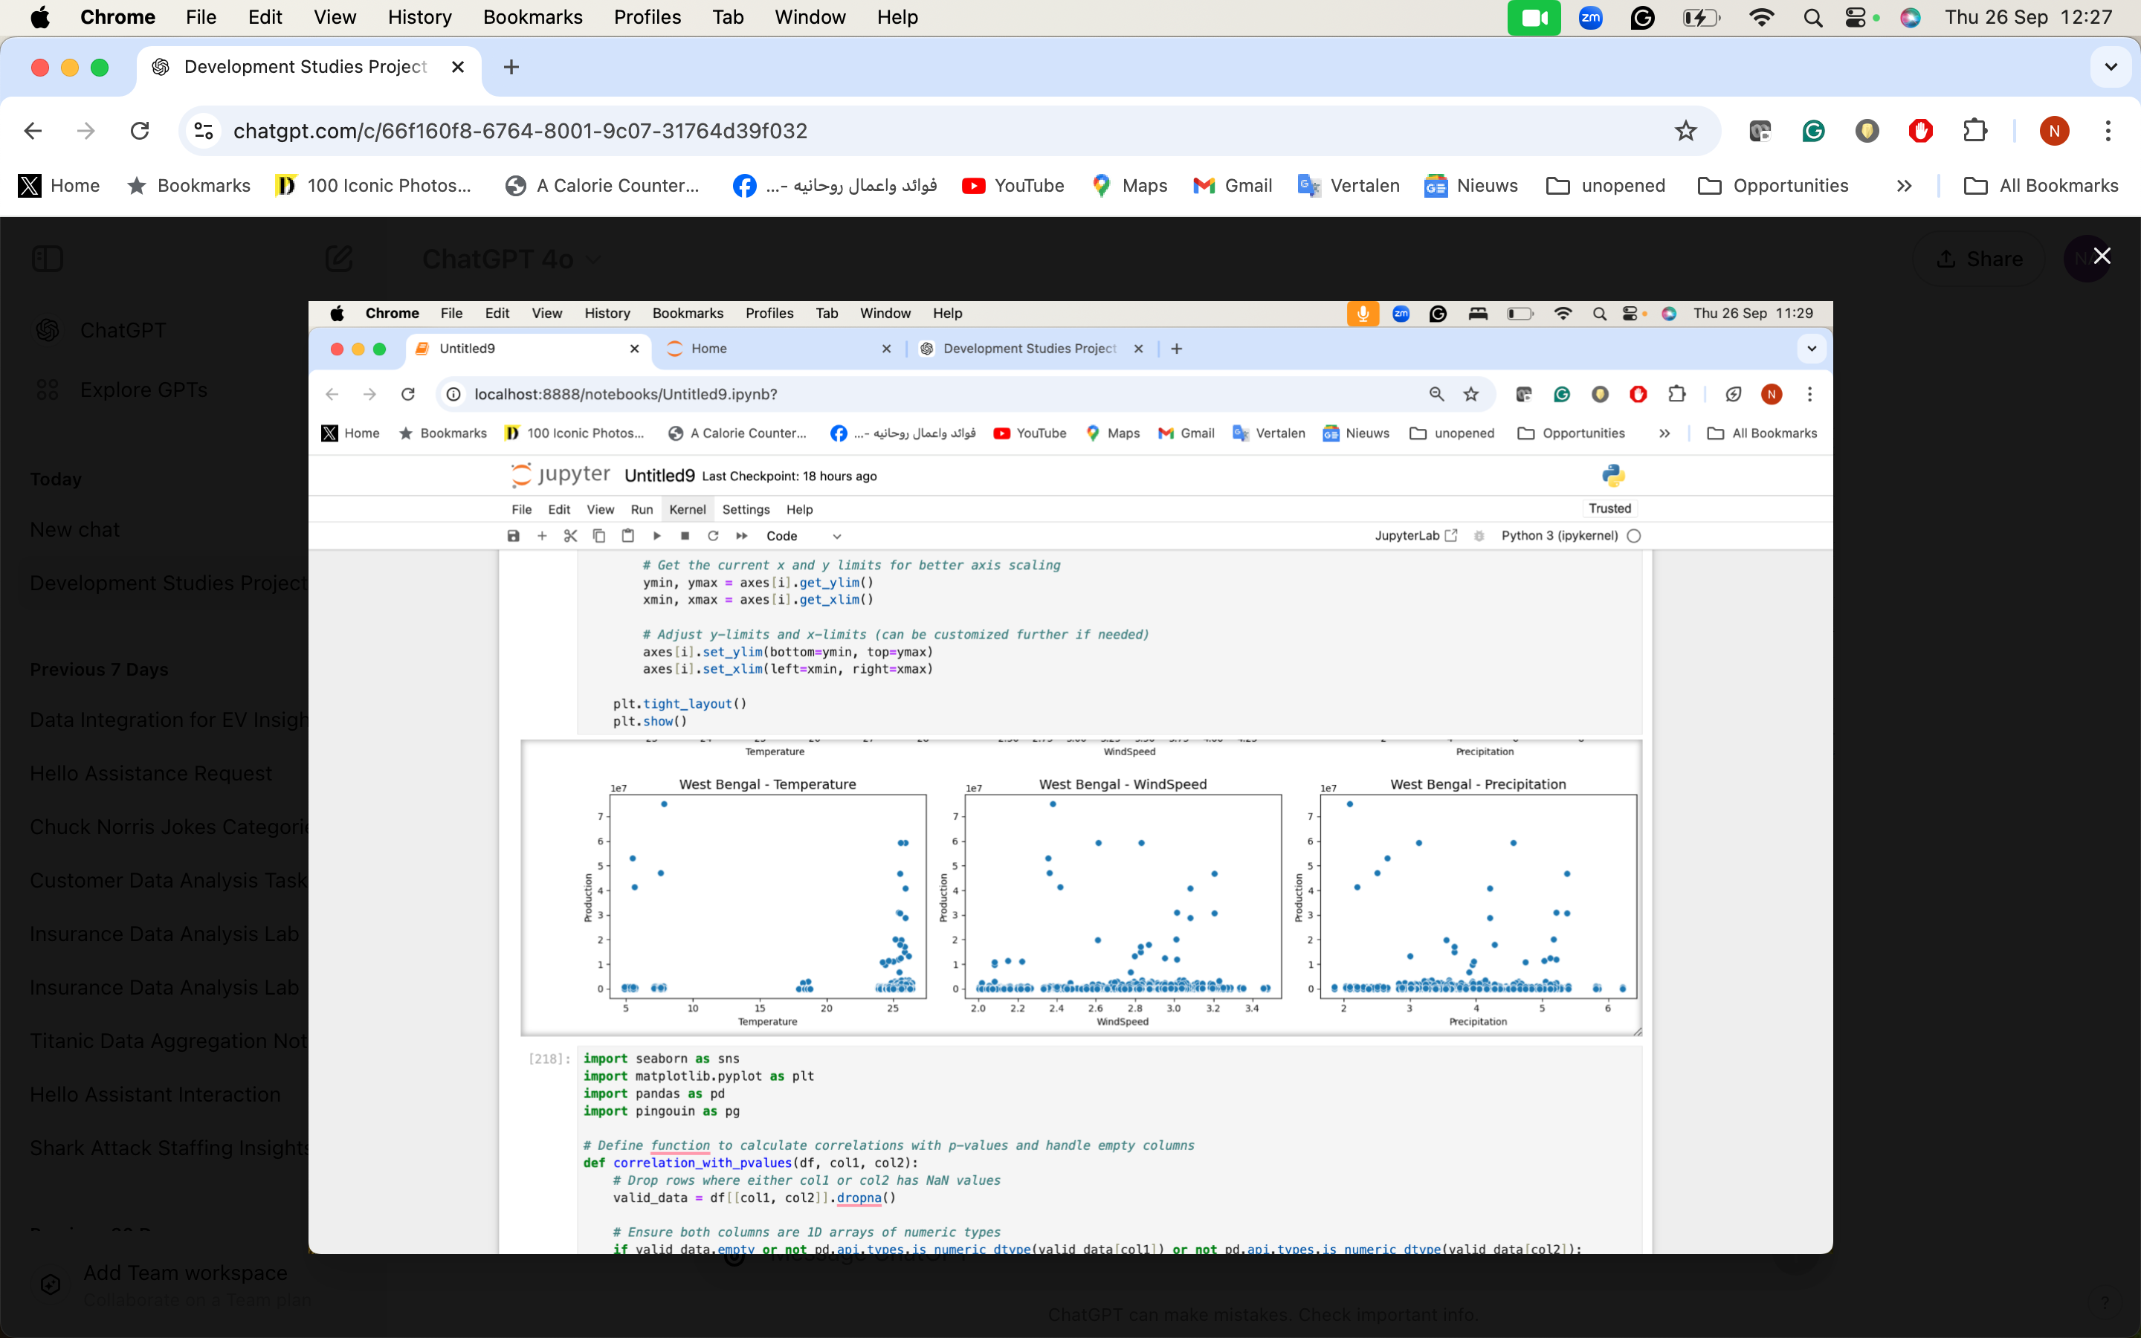
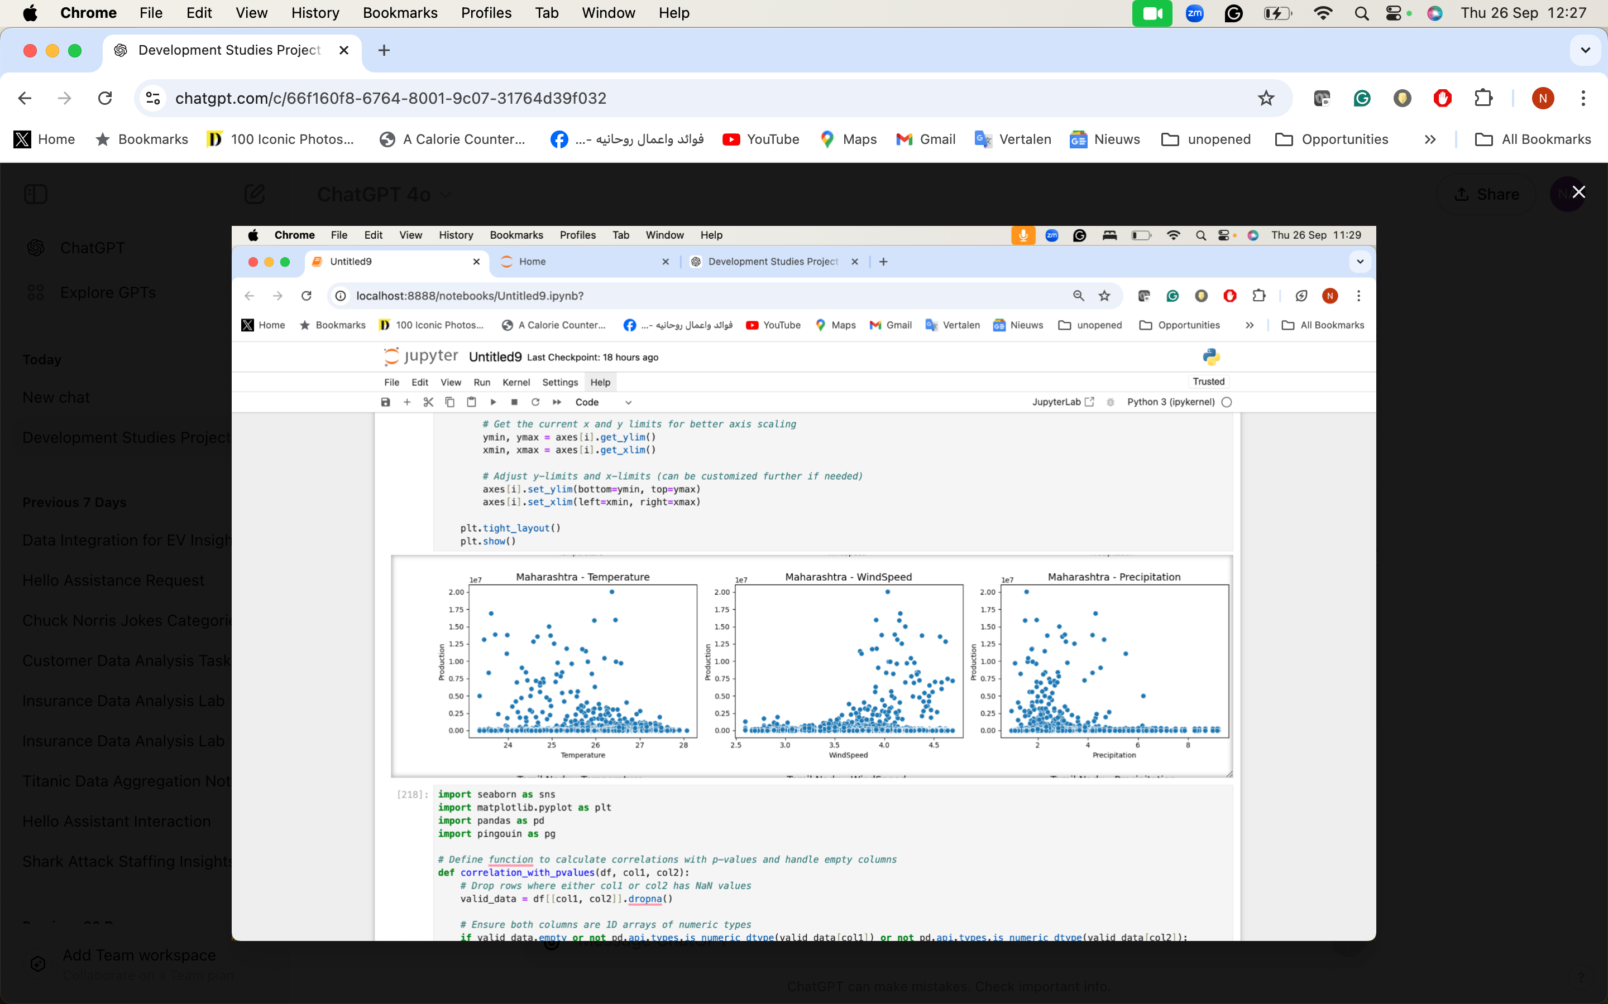
Regional Variations in Environmental Impact
States like Andhra Pradesh, Bihar, and Kerala show higher production with specific temperature and precipitation ranges. WindSpeed has minimal impact across most states, but precipitation greatly affects production in Assam and Kerala.

Slide 7
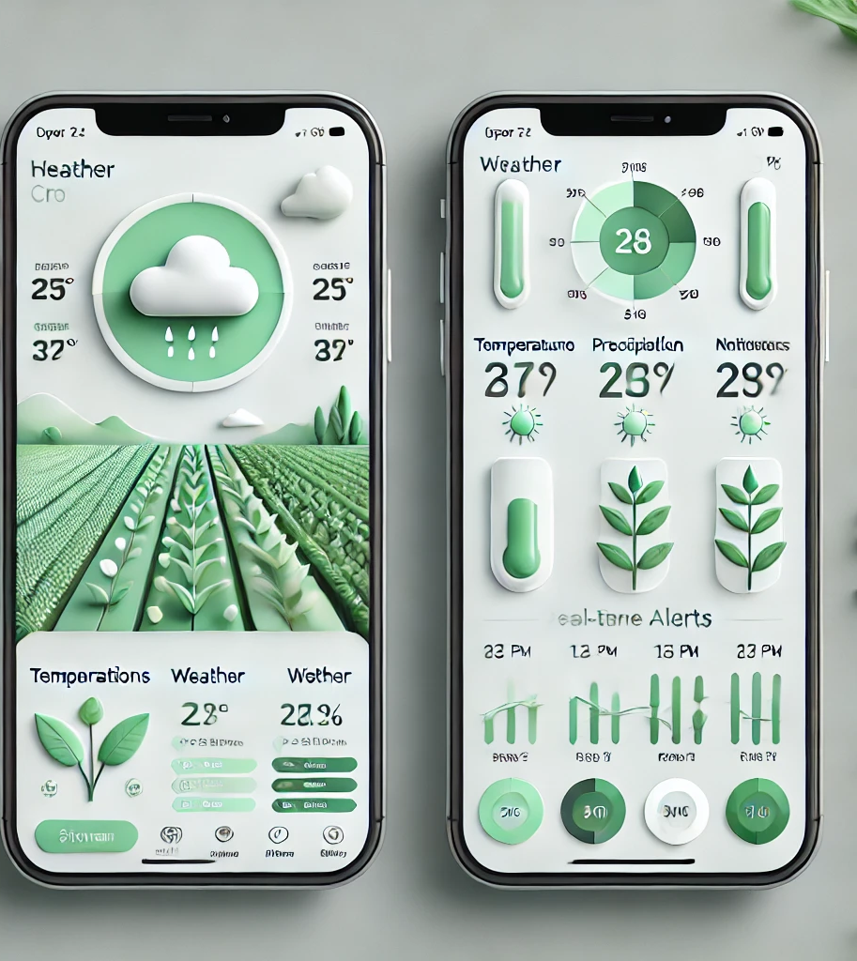
Business Idea: A Smart Agriculture Platform for Crop Yield Optimization
Farmers and industries know how to optimize their crop yield, but climate change and temperature increases are causing more uncertainty for farmers.
Develop a SaaS platform providing real-time insights by integrating weather data and environmental insights with crop production data, the platform will:
Predict optimal planting times based on weather forecasts.
Identify the best crops to plant based on the upcoming season's environmental conditions.
Provide real-time alerts for regions where weather anomalies may affect crop yield (e.g., sudden drops in temperature or drought).

Slide 8
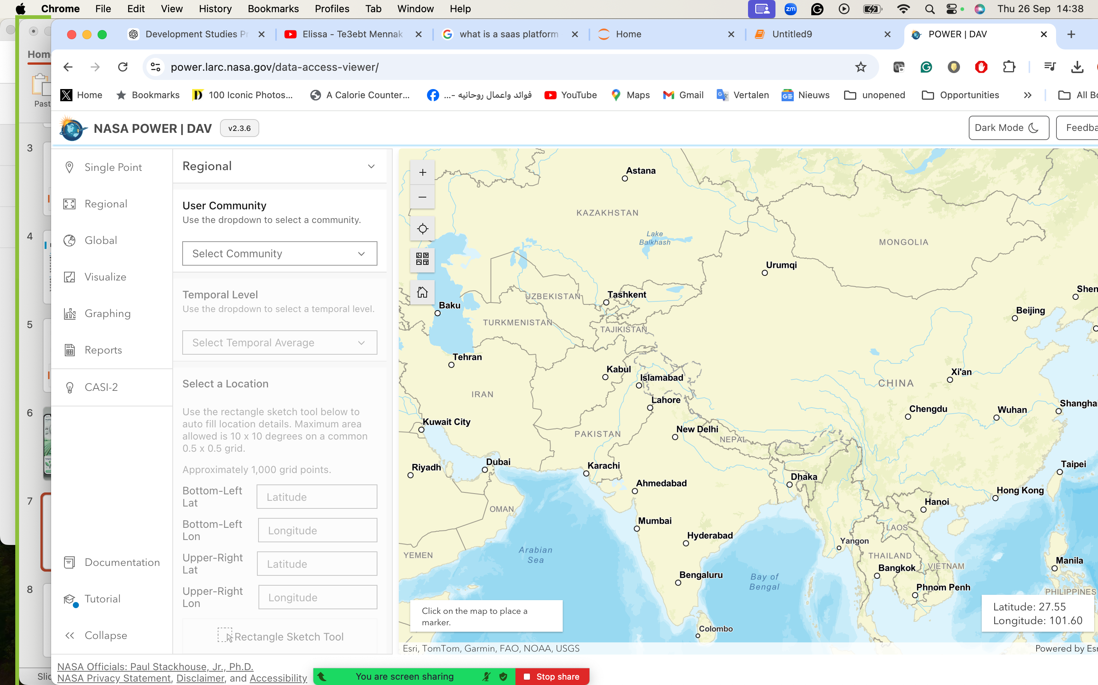
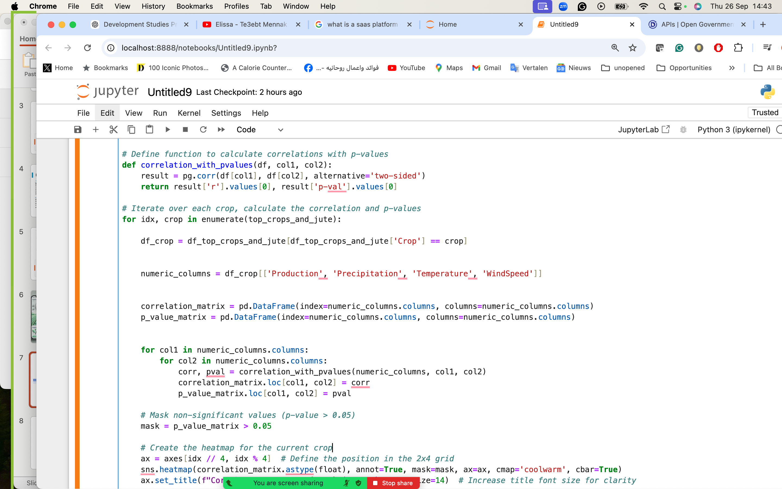

Methods
APIs:
Downloaded real-time and historical weather data via API from NASA Power,
Downloaded geospatial coordinates via OPEGEO, & Historical crop data from the indian government
Data Handling with NumPy: Utilized NumPy for efficient numerical operations on the scraped dataset.
Data Cleaning and Manipulation:
Employed the Pandas library for cleaning, manipulating, and pivoting the data to prepare it for analysis.
Analysis with Scikit-Learn:
Used Scikit-Learn for implementing machine learning algorithms to analyze the relationships between weather patterns and agricultural production.
Data Visualization:
Created visual representations of the data using Matplotlib to illustrate findings and insights.

Slide 9
Challenges
Data Collection Difficulties:
The primary challenges include difficulties in obtaining comprehensive, high-quality data on crop performance due to inconsistent collection methods and limited real-time access.
Understanding Climate-Crop Relationships:
Complexity in identifying how different climatic factors (temperature, rainfall, humidity, etc.) impact crop growth and variability in climate patterns across regions makes it harder to analyse the data.

Slide 10

Strides towards climate adaptability! Thank you.
Prepared by:
Linh, Supriya, & Nancy

